Slide 1

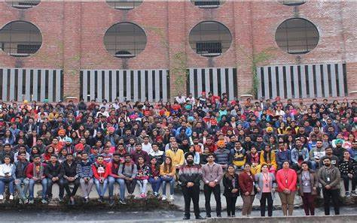
THE ROAD TO SUCCESS :
STUDENT PERSPECTIVE ON COURSE SELECTION
Presented by: -
OM JAISWAL 12207638
HARSH SINGH 12208874
ANUBHAV SINGH 12208856
ASHISH KR SINGH 12209185
MOHAMMAD FAHAD KHAN 12214398
Guided By:-
Dr.Mithilesh Kumar Dubey

Slide 2

Overview
01
02
03
04
05
INTRODUCTION
Motivation and Purpose of research
Research Questions:
DATA PREPROCESSING
DATA COLLECTION
06
07
08
09
10
DESCRIPTIVE STATISTICS
DATA VISUALIZATION
DATA INSIGHTS
CHALLENGES & LIMITAIONS
CONCLUSION

Slide 3


INTRODUCTION
Explores how people decide what to study by looking at the things that influence their choices.
It's like peeling back layers to see what's really behind your decisions. We'll dig into why "He/She" might pick a certain course, considering their own interests, what others say, and what society expects.

Slide 4
Motivation and Purpose of research
Exploring Decision-Making Dynamics: The primary motivation of this research is to delve into the decision-making dynamics behind students' course selection process. By understanding the factors that influence students' choices, we aim to gain insights into their motivations, aspirations, and challenges.
Informing Educational Practices: One of the key purposes of this research is to inform educational practices and policies. By uncovering the factors that shape students' course selection decisions, we can provide valuable insights to educational institutions, policymakers, and stakeholders. This information can be used to tailor educational programs, support services, and resources to better meet the needs and preferences of students.
Empowering Student Decision-Making: We believe that empowering students to make informed decisions about their education is essential for their academic success and future career prospects. Through our research, we aim to equip students with the knowledge and understanding they need to navigate the course selection process effectively.
Enhancing Student Engagement and Satisfaction: By understanding what motivates students to choose particular courses of study, educational institutions can better engage with their student population and enhance overall satisfaction. Our research aims to identify areas where improvements can be made to enhance the student experience and promote academic success.
Contributing to the Scholarship of Teaching and Learning: Lastly, our research contributes to the scholarship of teaching and learning by providing valuable insights into student behaviors and decision-making processes within the educational context. By sharing our findings with the broader academic community, we hope to stimulate further research and discussion on this important topic.

Slide 5
Research Questions:
Influence of Peer Recommendations: To what extent do recommendations from peers influence students' decisions when selecting a course of study?
Impact of Academic Guidance: How does seeking advice or guidance from teachers, counselors, or mentors affect students' decision-making process when choosing what to study?
Role of Financial Stability: What role does financial stability play in students' decision-making process, and how does it influence their course selection?
Degree of Self-Reflection: To what extent do students rely on self-reflection when determining what to study, and how does this influence their decision-making?
Handling Overwhelm: How do students cope with feeling overwhelmed or confused by the multitude of options available when deciding what to study?
Perception of Institution's Reputation: How much emphasis do students place on the reputation or ranking of the institution offering the program they're interested in?
Fear of Failure: How does the fear of failure influence students' decision-making process when choosing what to study, and how do they mitigate this fear?
Academic Pressure Perception: How do students perceive the level of academic pressure they face from expectations such as grades and performance?
Affordability Satisfaction: How satisfied are students with the affordability of their current course of study, and what factors contribute to their satisfaction or dissatisfaction?
Financial Support Comfort: How comfortable are students with the level of financial support (e.g., scholarships, grants, loans) available for their current course of study?
Perceived ROI Justification: Do students feel that the potential return on investment (ROI) of their current course of study justifies the financial investment required?
Decision Changes Over Time: How common is it for students to change their minds about what to study after initially making a decision, and what factors contribute to these changes?

Slide 6

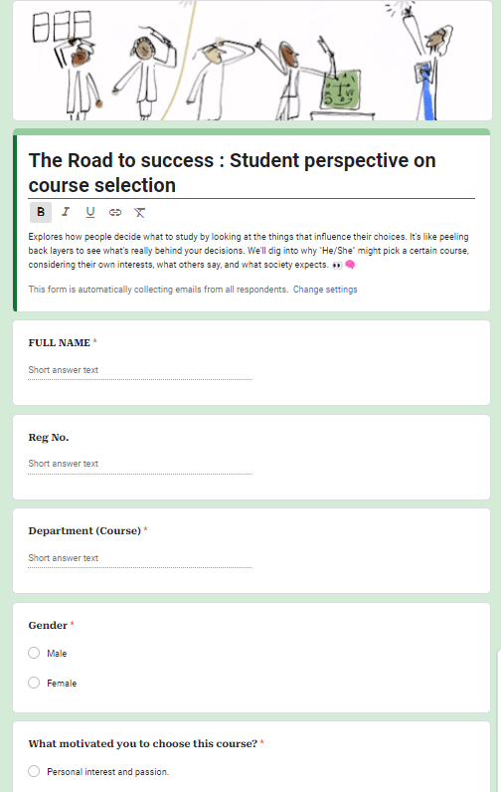
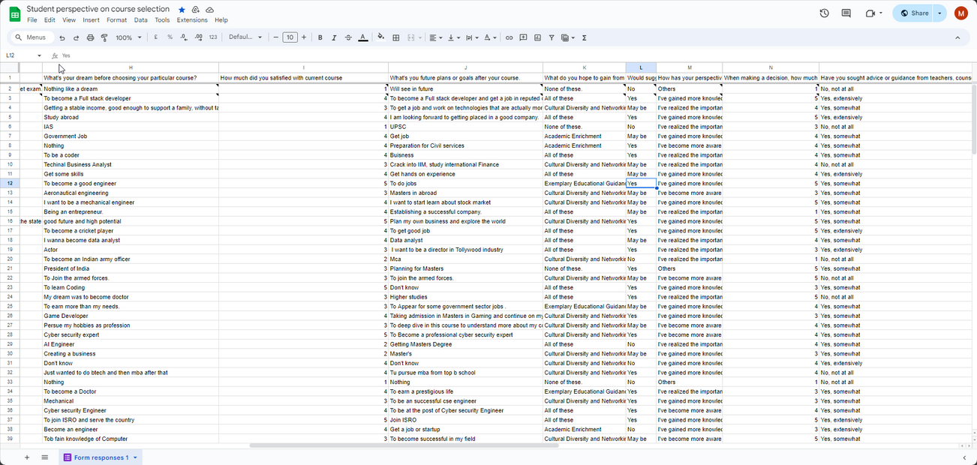
DATA COLLECTION

Slide 7




DATA PREPROCESSING
Collected data from students from different departments.
dealing with misssing data
Explore the dataset to find meaningful insights
Transform raw data into relational databaset.
COLLECTION
CLEANING
EXPLORATION
TRANSFORMATION

Slide 8
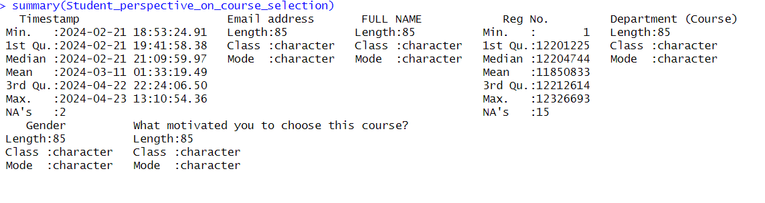
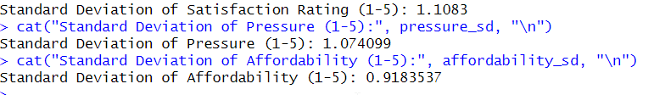
DESCRIPTIVE STATISTICS

Slide 9
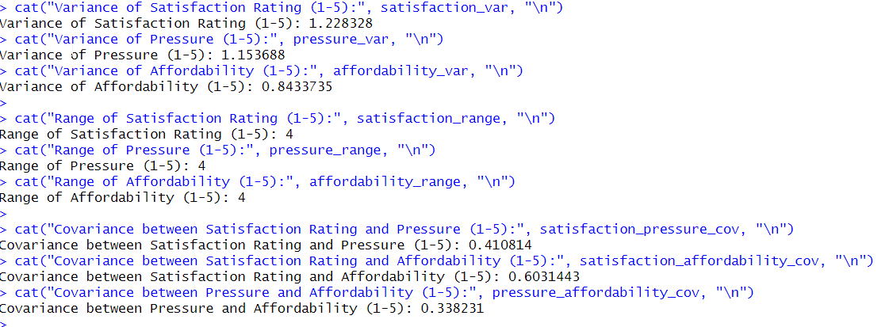
DESCRIPTIVE STATISTICS

Slide 10


DESCRIPTIVE STATISTICS ON STUDENT FEEDBACK

Slide 11

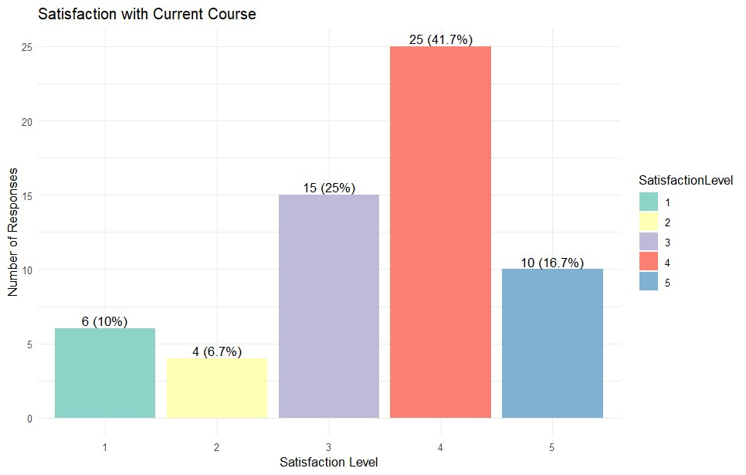
DATA VISUALIZATION

Slide 12
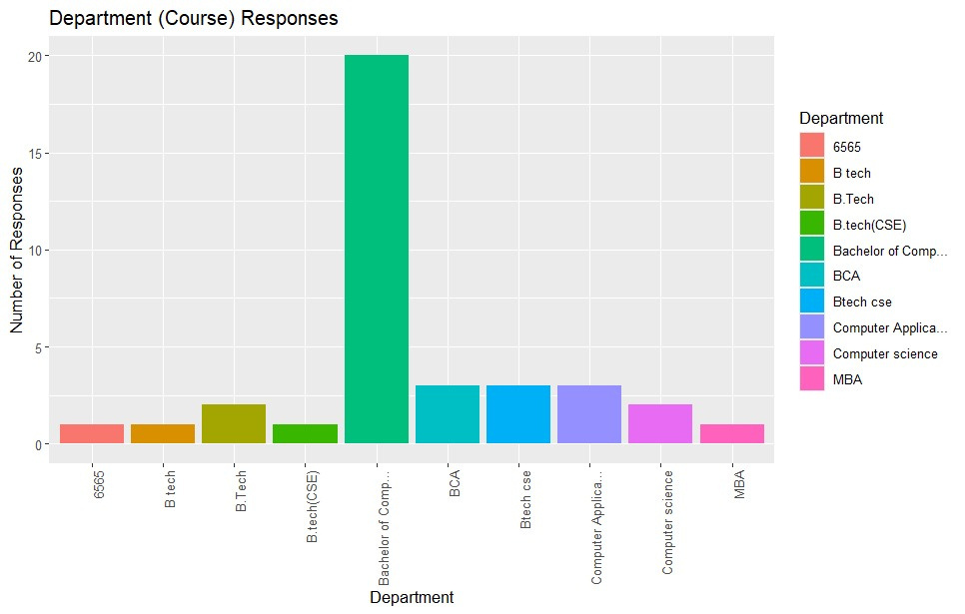

Slide 13
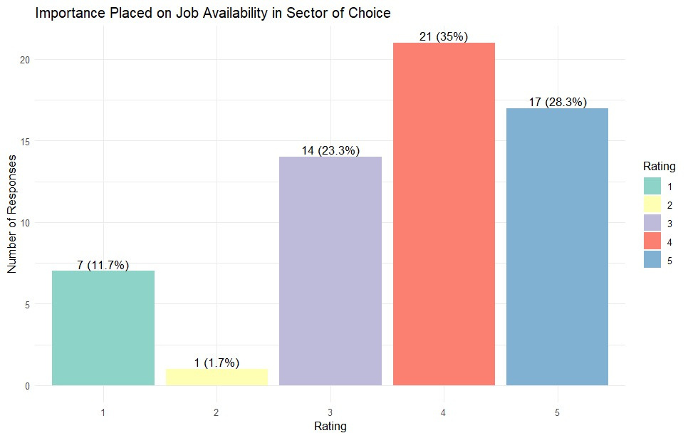

Slide 14
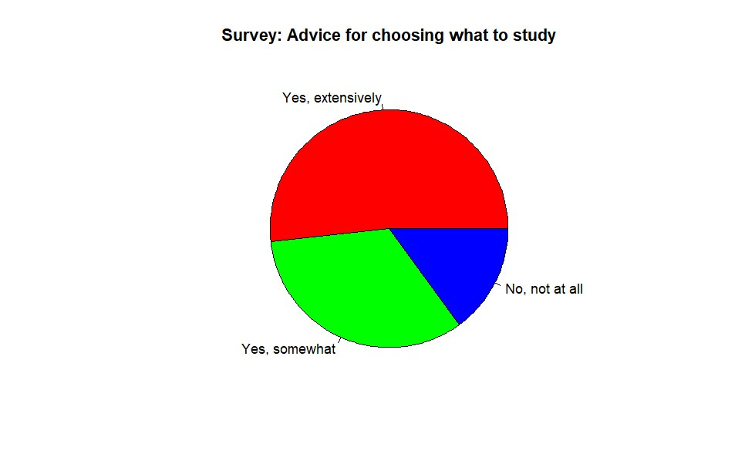

Slide 15
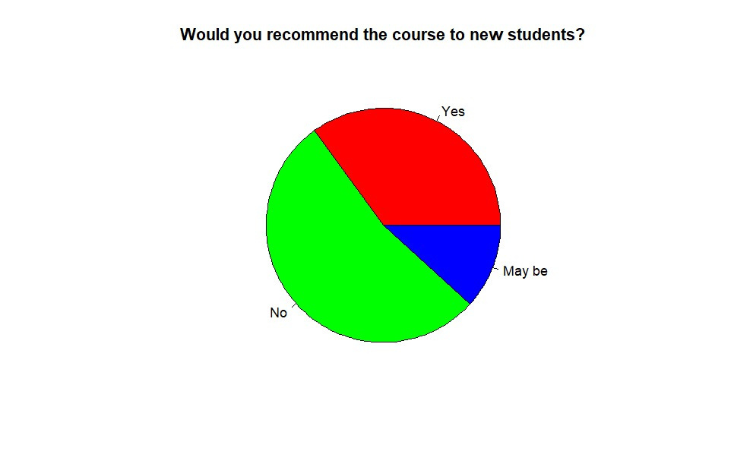
Would suggest your current \"Course\" with new students?

Slide 16

DATA INSIGHTS
29 (48.3%) Students are changed their mind about what to study after initially making a decision
12(20%) Students recommended from family or friends to choose their course
32(53.3%)Students have fear of failure influence their decision-making process when choosing what to study

Slide 17
Challenges and Limitations
Data Collection Bias: The survey primarily targeted BCA students, resulting in an overrepresentation of this group. This may limit the generalizability of findings to other student populations or academic fields.
Limited Response Rate: Despite efforts, a significant portion of students did not respond, leading to a small dataset. This reduces the statistical power and reliability of the analysis and limits the ability to draw broad conclusions.
Self-Reported Data Accuracy: Reliance on self-reported responses introduces the potential for response bias and inaccuracies. Respondents may provide socially desirable answers, impacting the credibility of the data and analysis.
Missing Data and Incomplete Responses: Presence of missing or incomplete data poses challenges in analysis and interpretation. Dealing with missing data requires imputation methods or exclusion, potentially biasing results.
Limited Scope of Variables: The survey's focus on specific aspects of course selection may overlook other relevant factors. This limits the depth and breadth of analysis, potentially missing important insights.
Time and Resource Constraints: Conducting thorough data exploration requires significant time, resources, and expertise. Limited resources and access to specialized tools may restrict the depth and rigor of the research.

Slide 18
CONCLUSION
In conclusion, this research project delved into the complexities of students' decision-making processes when selecting courses. By exploring various influencing factors such as peer recommendations, financial stability, academic pressure, and satisfaction levels, we gained valuable insights into students' motivations, aspirations, and challenges.
The primary goal of this research was to empower students to make informed decisions about their education, leading to academic success and improved career prospects. Our findings highlight the multifaceted nature of the course selection process and underscore the importance of providing students with the necessary support and resources to navigate it effectively.
Through sharing our insights with the academic community, we aim to contribute to the enhancement of educational practices and policies, ultimately fostering greater student engagement, satisfaction, and success. It is our hope that this research will inspire further discussions and initiatives aimed at improving the course selection experience for students, ultimately enhancing their academic journey.

Slide 19


